Slide 1
BREAK-EVEN ANALYSIS

Slide 2
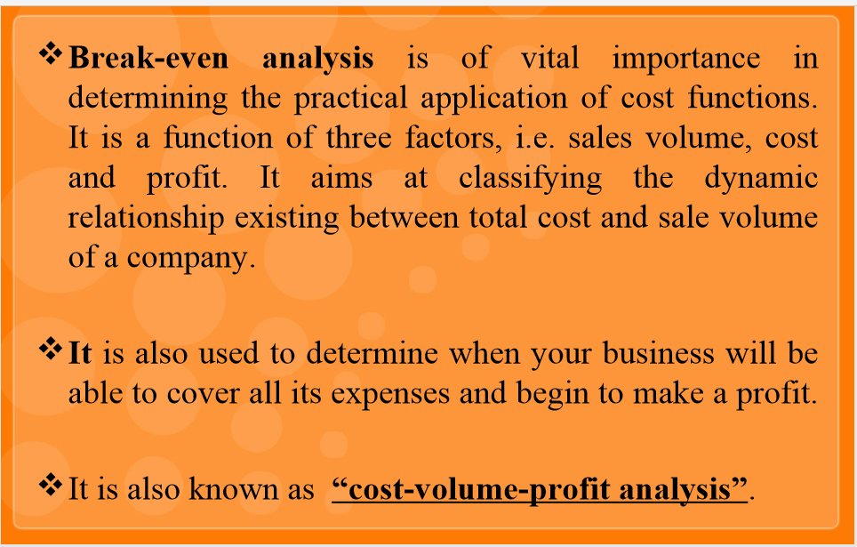
Introduction

Slide 3
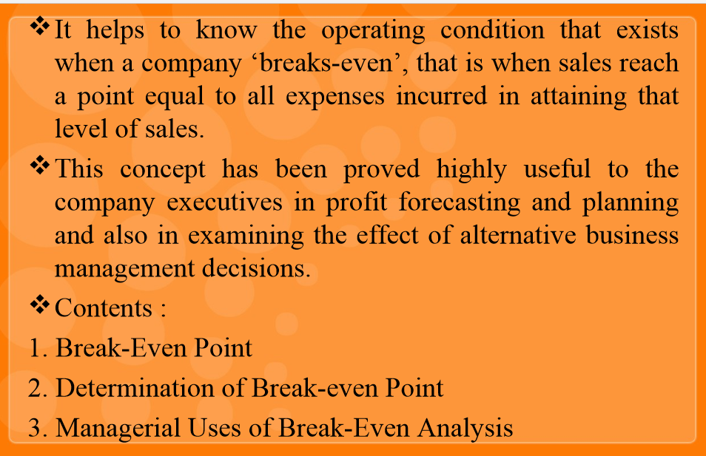

Slide 4
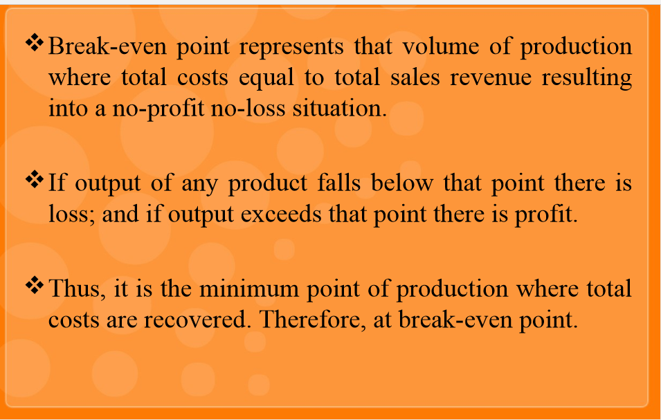
BREAK-EVEN -POINT

Slide 5
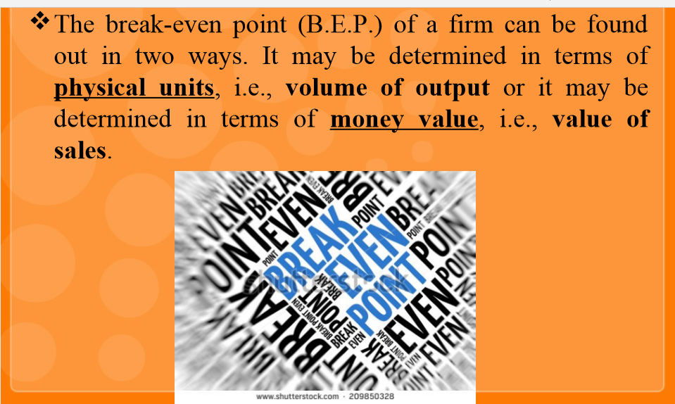

Slide 6
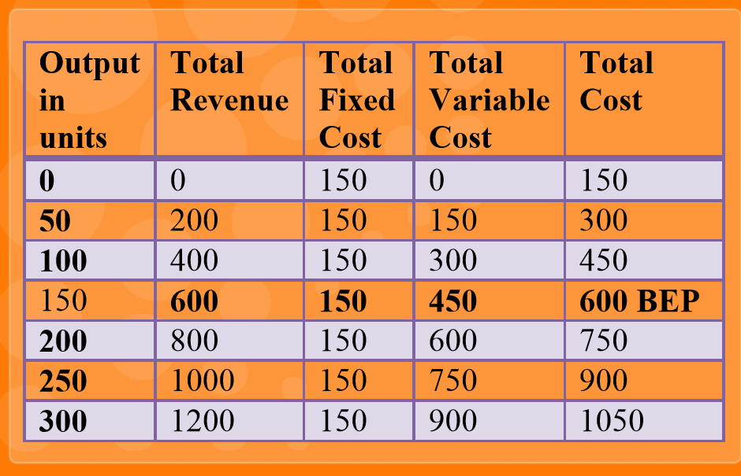

Slide 7


Slide 8
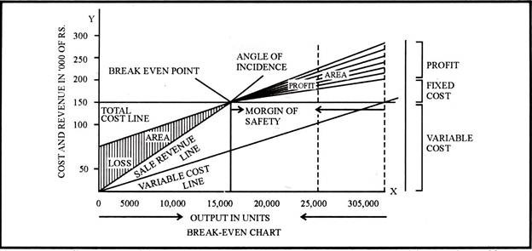

Slide 9
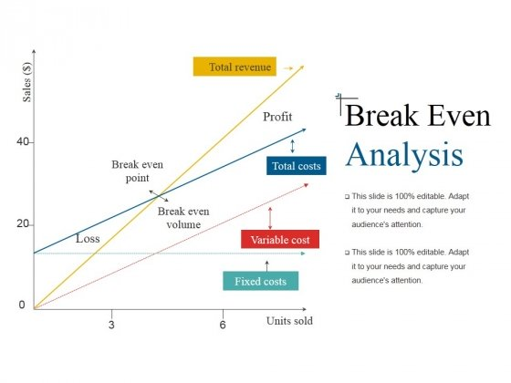

Slide 10
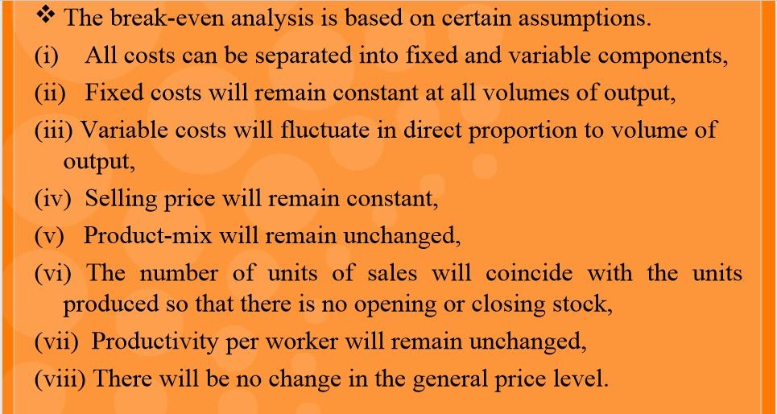
ASSUMPTIONS OF BE ANALYSIS

Slide 11
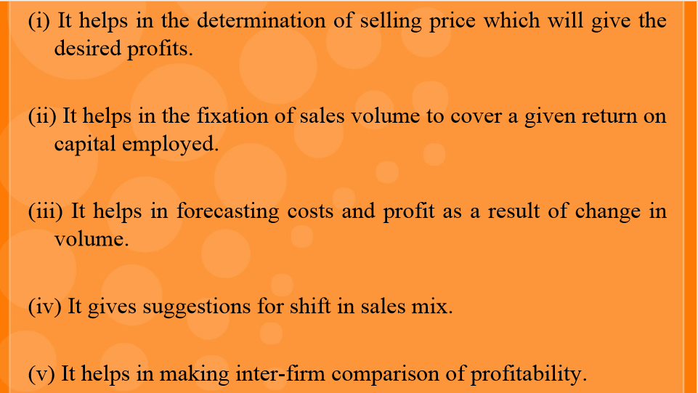
USEFULNESS OF BE ANALYSIS

Slide 12
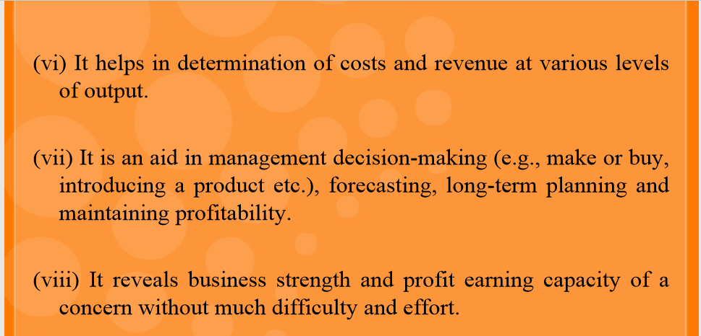
CONTD..

Slide 13
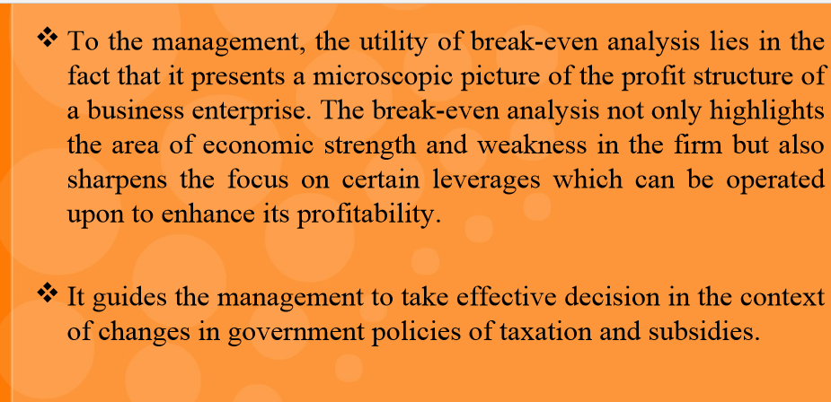
MANAGERIAL USES/SIGNIFICANCE OF BE ANALYSIS

Slide 14
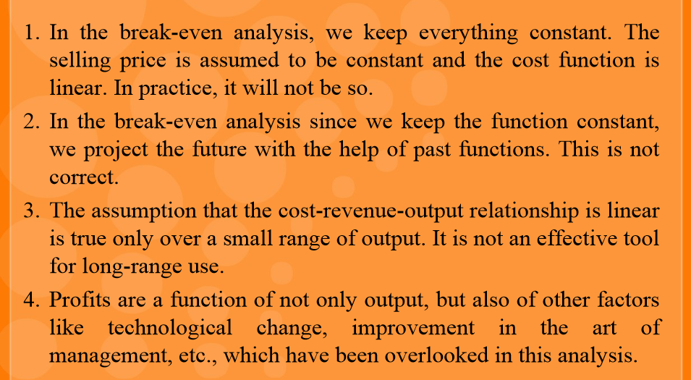
LIMITATIONS OF BE ANALYSIS

Slide 15
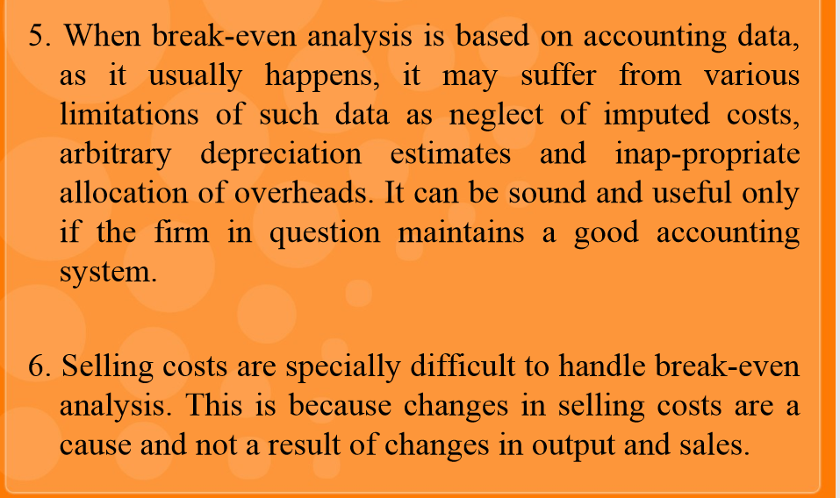
CONTD..

Slide 16
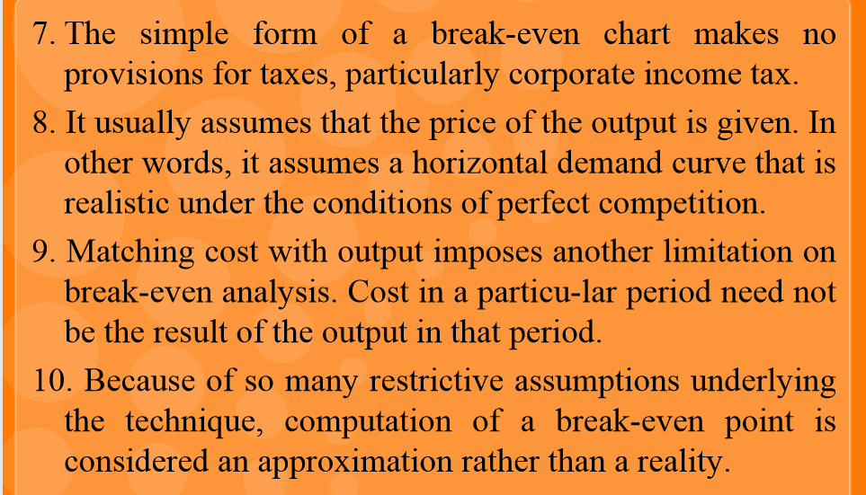
CONTD..

Slide 17
FORMULAS IN B-E-P ANALYSIS
1) Profit = Total sales or Revenue – Total cost (or)
Sales – (Fixed cost + Variable cost) (or)
Sales – Fixed cost – variable cost
2) Contribution = Sales – Variable cost (or)
Fixed Cost + Profit
Contribution = Sales – V.C = F.C + Profit

Slide 18
3) Variable cost or Marginal cost = Direct Material + Direct Labor +Direct Expenses
4) B.E.P (Units) = Fixed cost (FC)
Contribution(C)
(Or) Fixed Cost (or) Fixed Cost
Sales – variable cost F.C+ profit
5) B.E.P (Value or Rupees) = Fixed cost × Sales (or) FC×S
Sales – variable cost Contribution
B.E.P(value) = BEP in Units × Selling price per unit

Slide 19
6) P/V Ratio or Profit/volume ratio = Contribution × 100
Sales
7) P/v Ratio ( when two years data given) = Change in profit ×100
Change in sales
8) BEP is calculated with the help of P/V Ratio = Fixed cost
P/v Ratio
9) F.C and V.C is calculated with help of following formulas:
Fixed cost = Sales × P/v Ratio – Profit
Variable cost = Sales × (1 – P/v Ratio)

Slide 20
10) Number of units required to earn Desired profit: Fixed Cost + Desired profit
Contribution
11) Sales required for Desired profit = Fixed cost + Desired profit× Sales
Sales – Variable Cost
(or) with the help of p/v Ratio = Fixed cost +Desired profit
P/V Ratio
12) Margin of Safety (MOS)
= Actual sales – BEP sales (or) Profit
P/V Ratio
13) MOS Ratio = MOS× 100
Sales
Note: MOS is the safety margin how much output or sales level can fall
before a business reaches its BEP.

